Slide 1

Handling Late Data and Watermarking

Slide 2
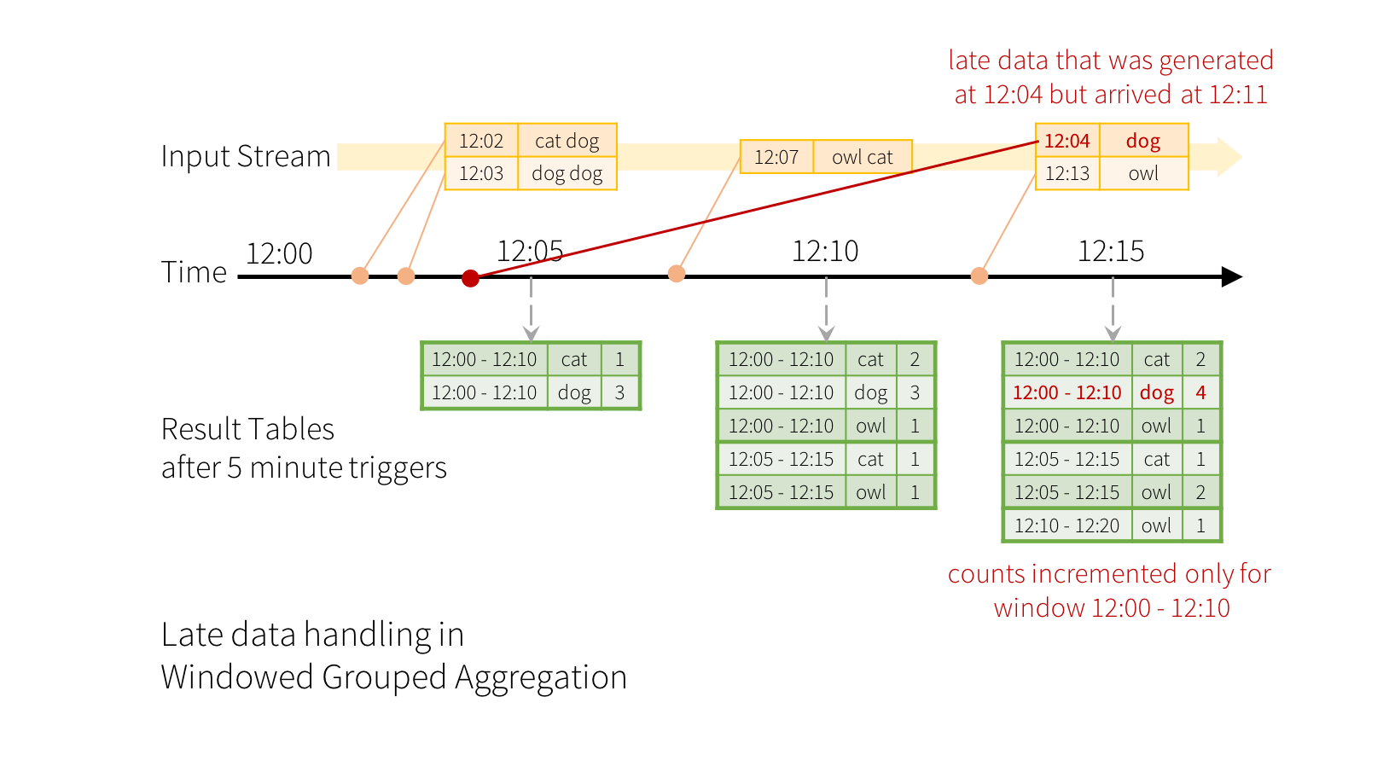

Slide 3
Watermarking example code
words = ... # streaming DataFrame of schema { timestamp: Timestamp, word: String }
# Group the data by window and word and compute the count of each group
windowedCounts = words \
.withWatermark("timestamp", "10 minutes") \
.groupBy(
window(words.timestamp, "10 minutes", "5 minutes"),
words.word) \
.count()
Notes:
reduceByKeyAndWindow(func, windowLength, slideInterval, [numTasks])
When called on a DStream of (K, V) pairs, returns a new DStream of (K, V) pairs where the values for each key are aggregated using the given reduce function func over batches in a sliding window. Note: By default, this uses Spark's default number of parallel tasks (2 for local mode, and in cluster mode the number is determined by the config property spark.default.parallelism) to do the grouping. You can pass an optional numTasks argument to set a different number of tasks
reduceByKeyAndWindow(func, invFunc, windowLength, slideInterval, [numTasks])
A more efficient version of the above reduceByKeyAndWindow() where the reduce value of each window is calculated incrementally using the reduce values of the previous window. This is done by reducing the new data that enters the sliding window, and “inverse reducing” the old data that leaves the window. An example would be that of “adding” and “subtracting” counts of keys as the window slides. However, it is applicable only to “invertible reduce functions”, that is, those reduce functions which have a corresponding “inverse reduce” function (taken as parameter invFunc). Like in reduceByKeyAndWindow, the number of reduce tasks is configurable through an optional argument. Note that checkpointing must be enabled for using this operation.

Slide 4
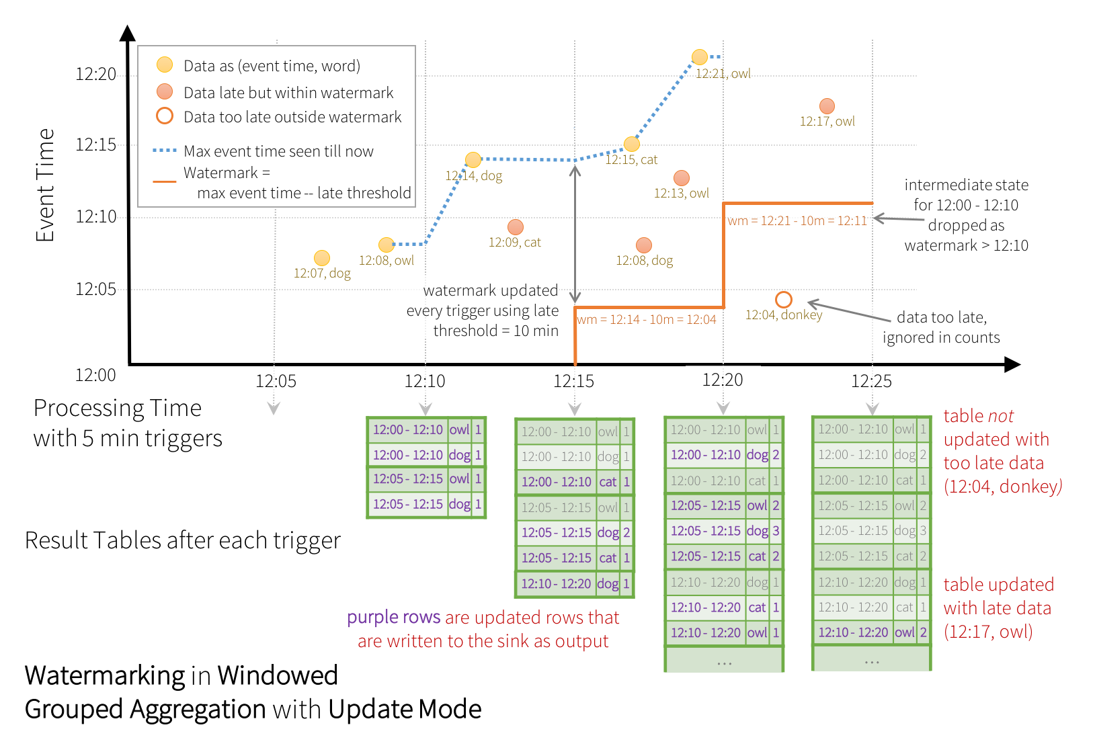

Slide 5
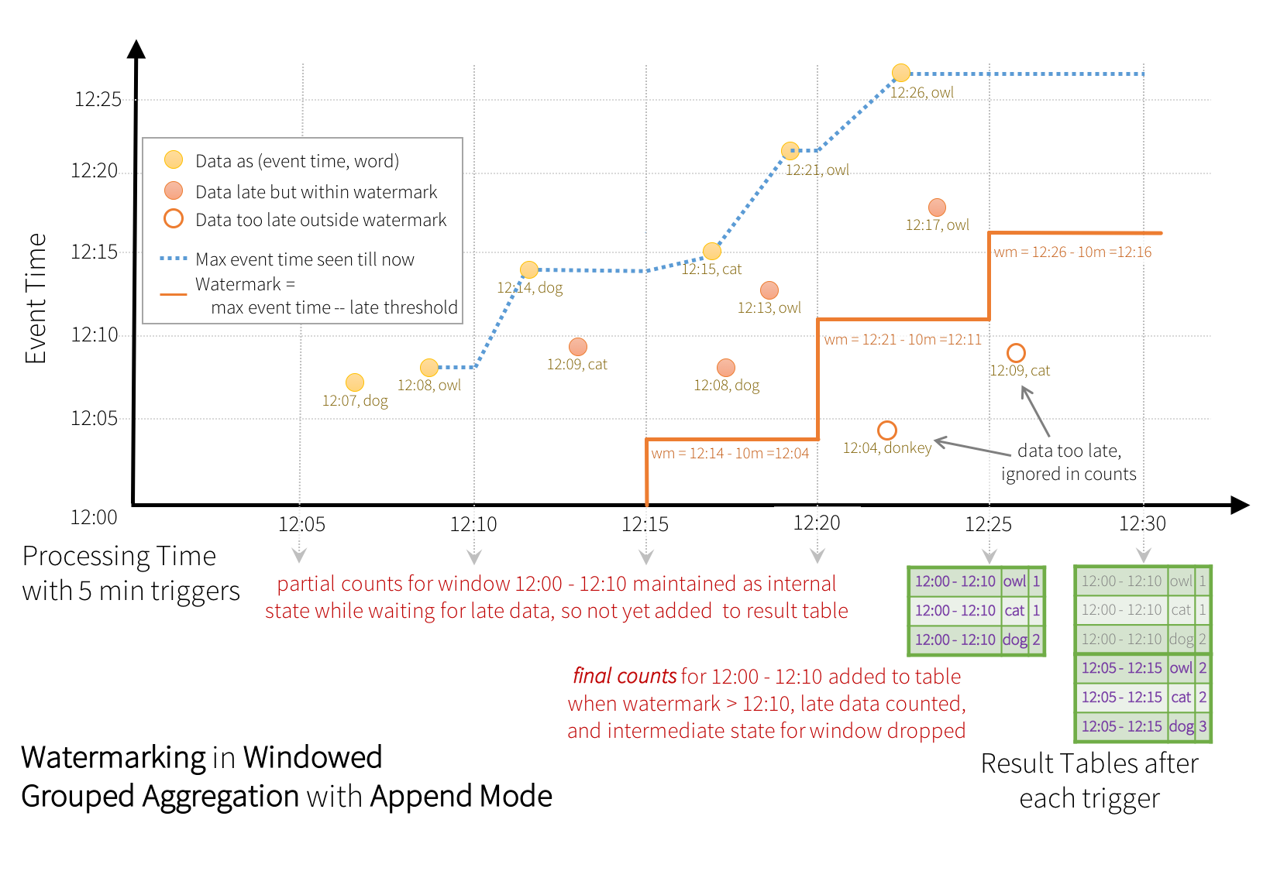

Slide 6
Conditions for Watermarking
Output mode must be set to Append or Update.
If it is set to Complete mode, it will requires all aggregate data to be preserved and will be incapable of using watermarking.
Aggregation needs either an event-time column, or a window on the event-time column.
withWatermark must be called on the same column as the timestamp column used in the aggregate, withWatermark must be called before the aggregation for the watermark details to be used.
Notes:
reduceByKeyAndWindow(func, windowLength, slideInterval, [numTasks])
When called on a DStream of (K, V) pairs, returns a new DStream of (K, V) pairs where the values for each key are aggregated using the given reduce function func over batches in a sliding window. Note: By default, this uses Spark's default number of parallel tasks (2 for local mode, and in cluster mode the number is determined by the config property spark.default.parallelism) to do the grouping. You can pass an optional numTasks argument to set a different number of tasks
reduceByKeyAndWindow(func, invFunc, windowLength, slideInterval, [numTasks])
A more efficient version of the above reduceByKeyAndWindow() where the reduce value of each window is calculated incrementally using the reduce values of the previous window. This is done by reducing the new data that enters the sliding window, and “inverse reducing” the old data that leaves the window. An example would be that of “adding” and “subtracting” counts of keys as the window slides. However, it is applicable only to “invertible reduce functions”, that is, those reduce functions which have a corresponding “inverse reduce” function (taken as parameter invFunc). Like in reduceByKeyAndWindow, the number of reduce tasks is configurable through an optional argument. Note that checkpointing must be enabled for using this operation.

